Slide 1

Online Portfolio Acess
User Manual

Slide 2
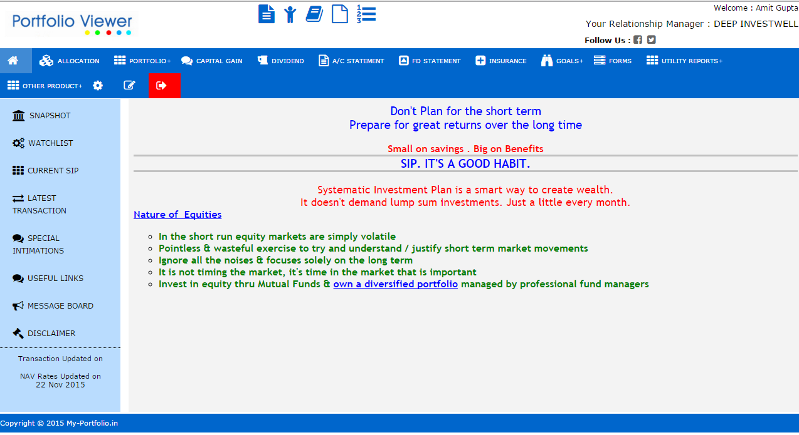
Welcome Screen
After login, user will view a Home Page, consisting of various report options.

Slide 3
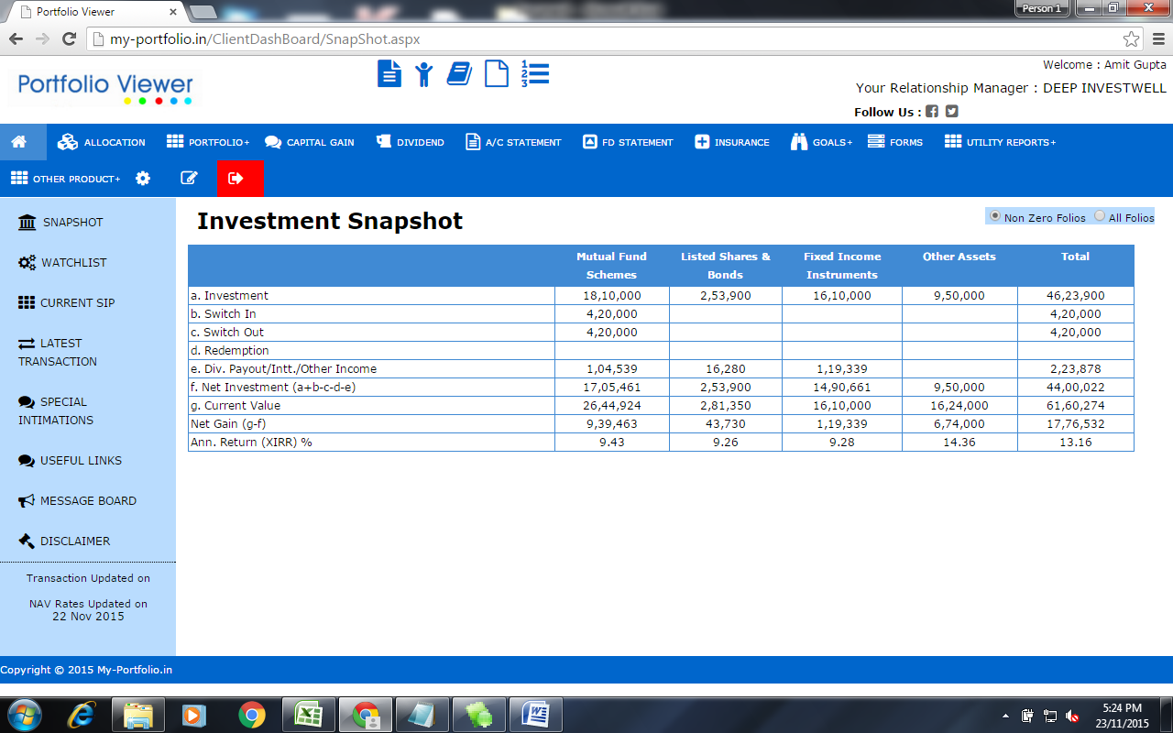
Snapshot
View product wise investment snapshot.
Includes Net Gain and Annualized (XIRR) Returns also.

Slide 4
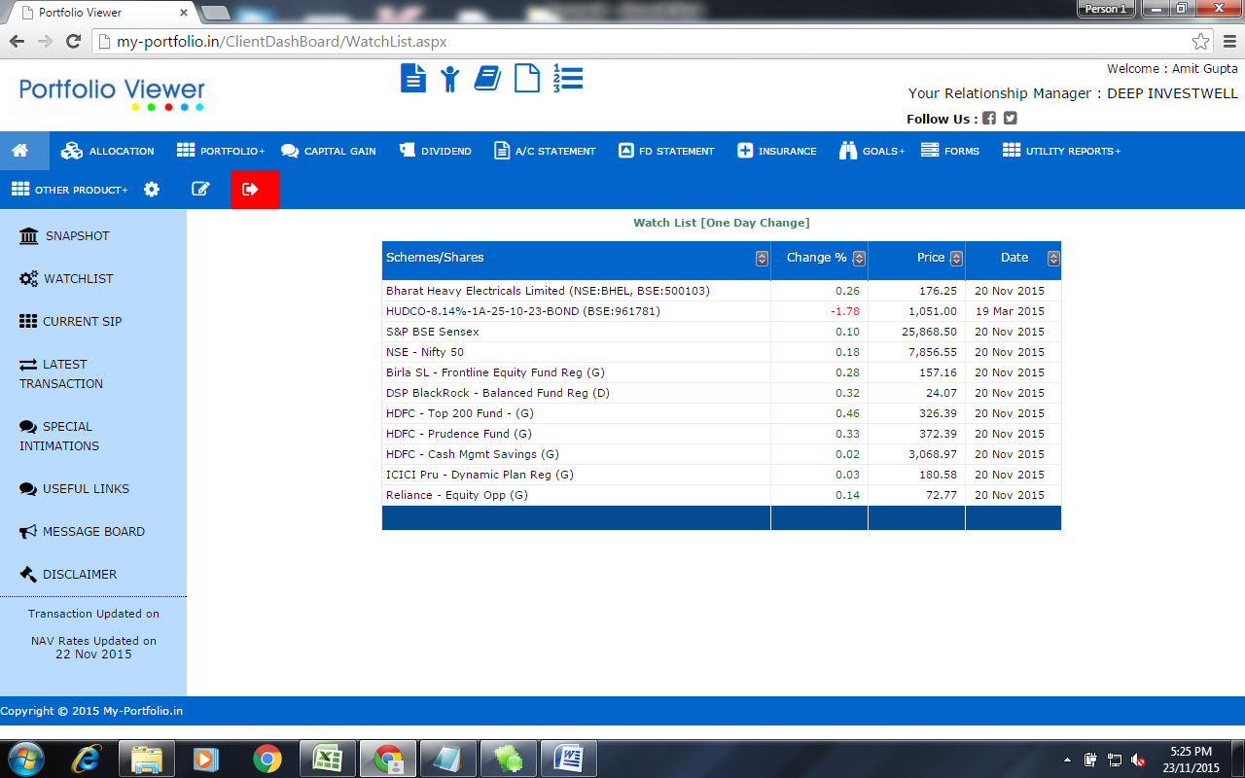
Watch list
View Daily Rate Variation in your invested schemes.

Slide 5
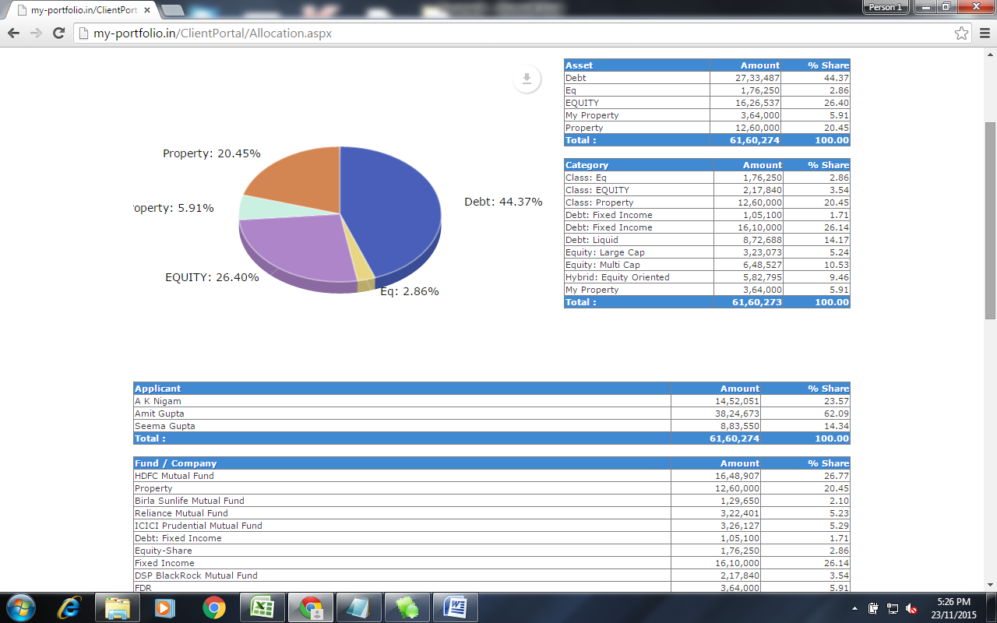
Allocation Analysis

Slide 6
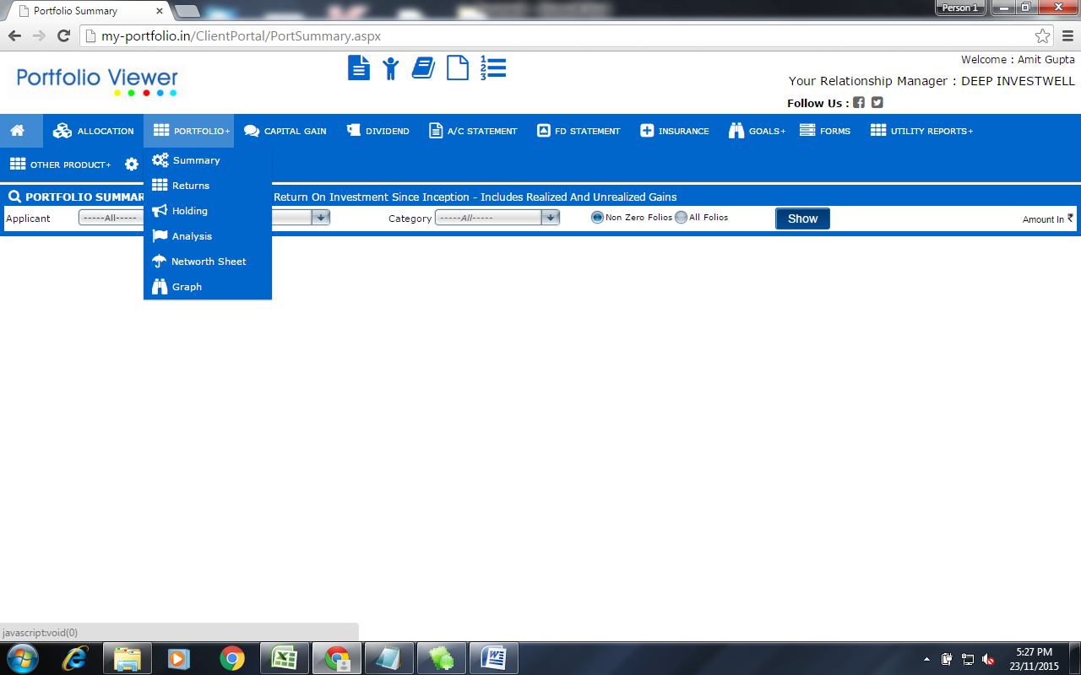
Portfolio Reports

Slide 7
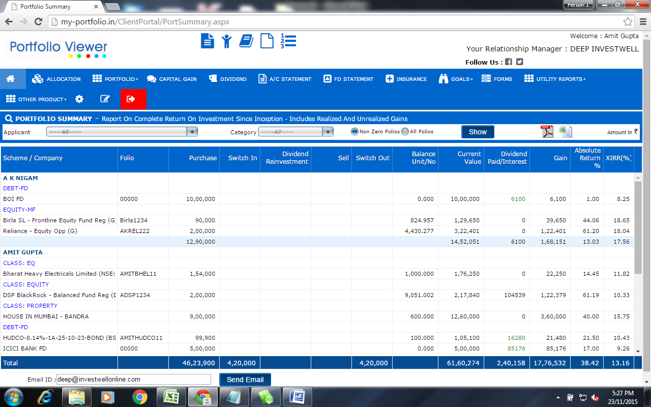
Portfolio Summary
Includes Realized and Unrealized Gains

Slide 8
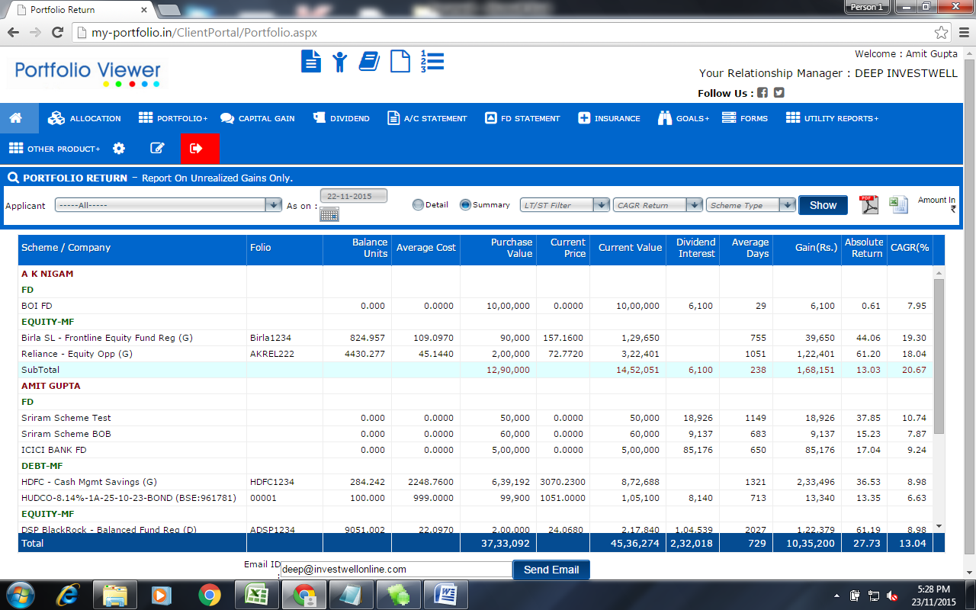
Portfolio Returns
View return on Currently held units.

Slide 9
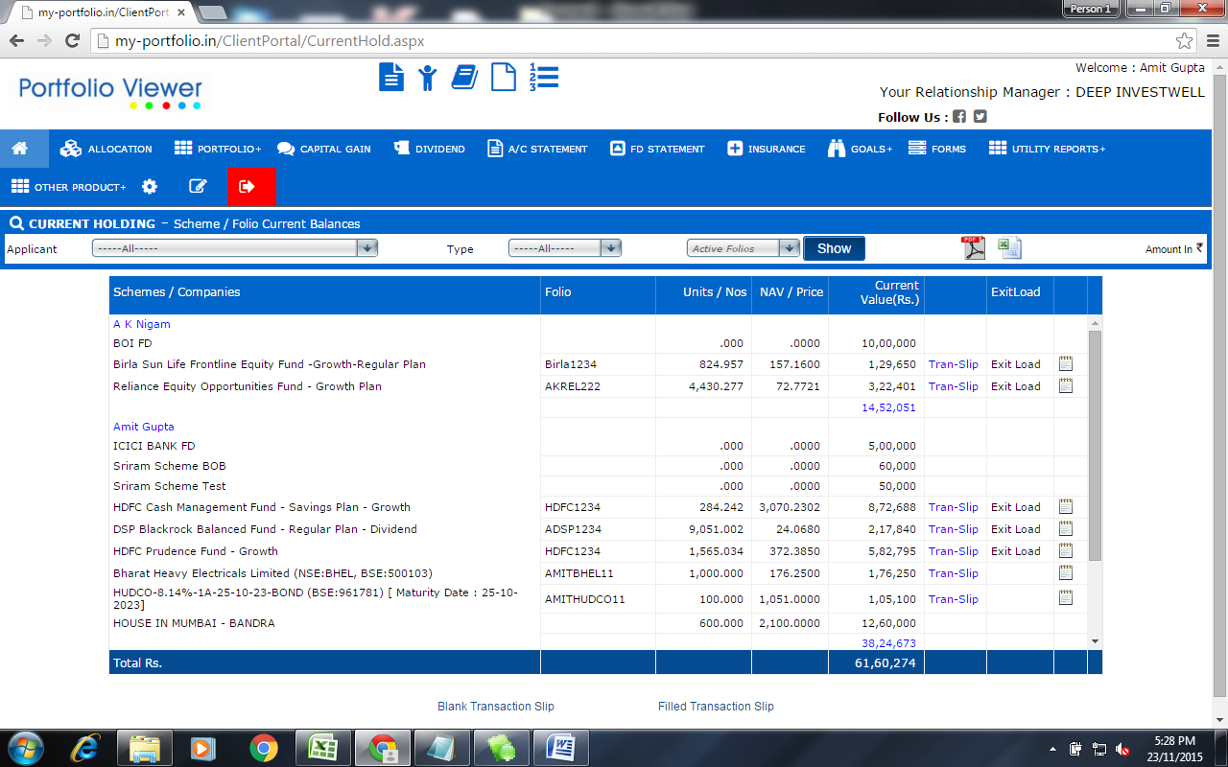
Current Holding
View Folio wise unit balances

Slide 10
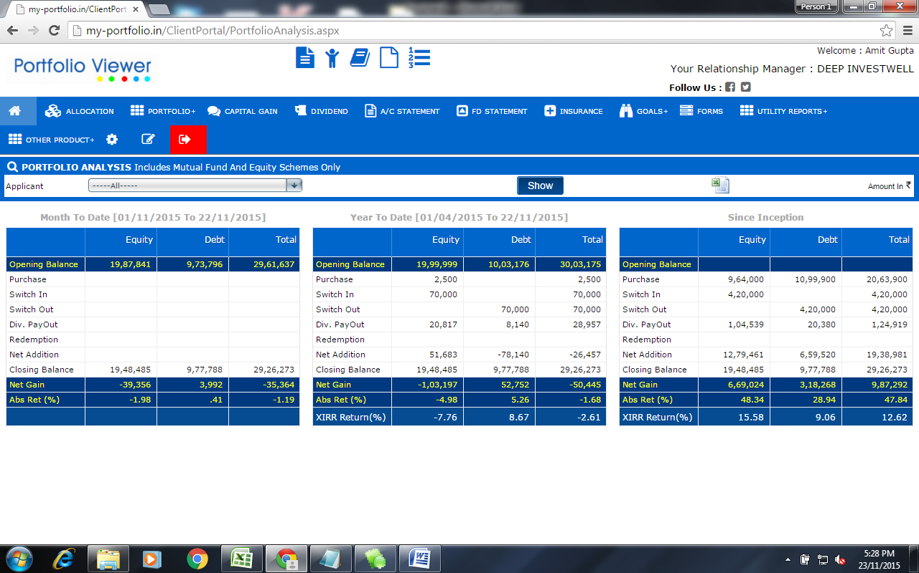
Analysis
View Returns MTD, YTD and since inception

Slide 11
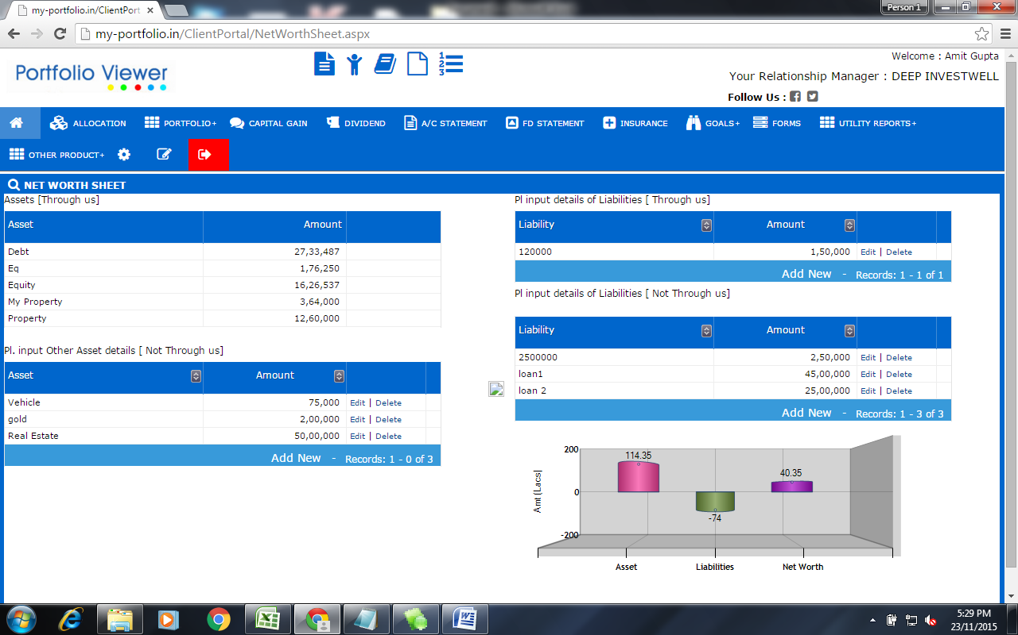
Net Worth
Input Other assets and liabilities and view your Net Worth

Slide 12
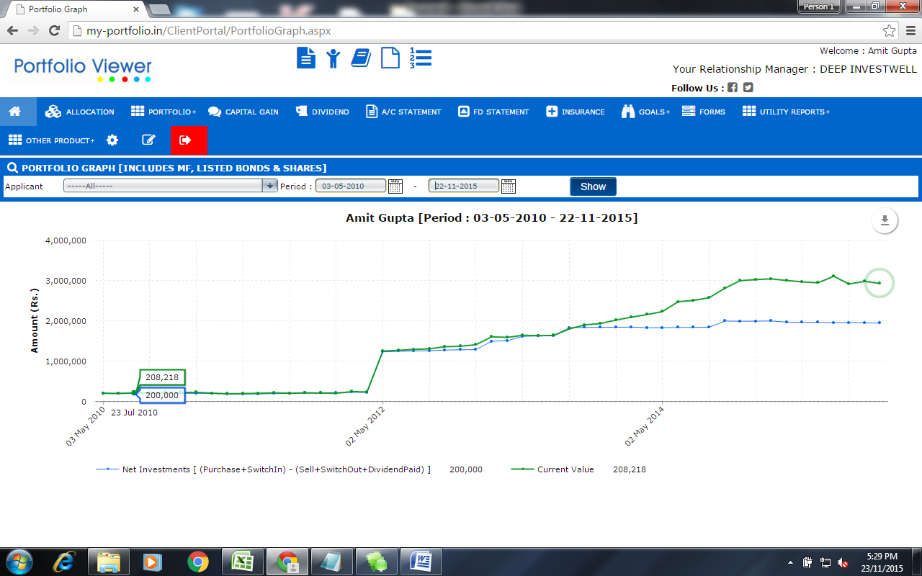
Portfolio Graph
View your Investment Progress !
(Net Investment and Net Worth is plotted with time)

Slide 13
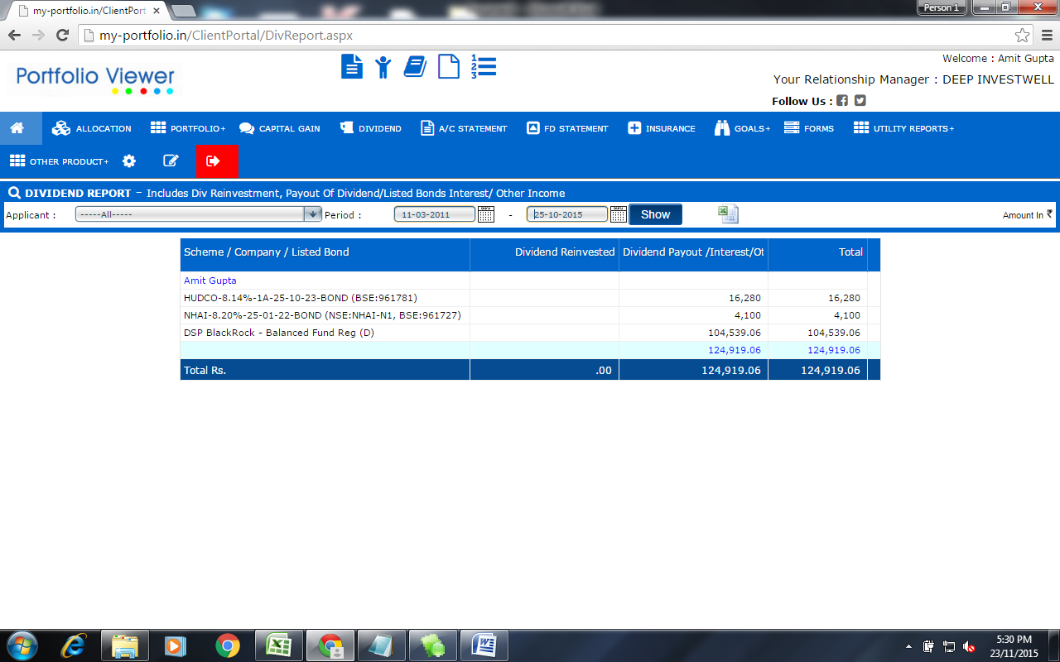
Dividend Report
View Dividends Paid out/Reinvested

Slide 14
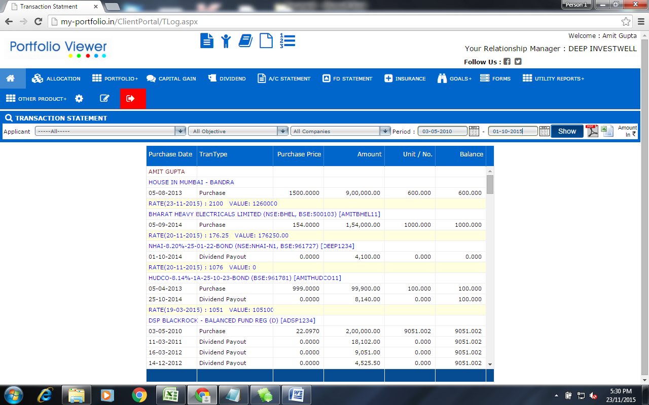
Transaction report
Date wise Transaction Listing

Slide 15


For any assistance, please contact us.
Happy Investing !

